Slide 1
Felipe Brunet Münnich
Agronomist, Avocado and Citrus Advisor
Director of the Technical Departament, Propal.

Slide 2
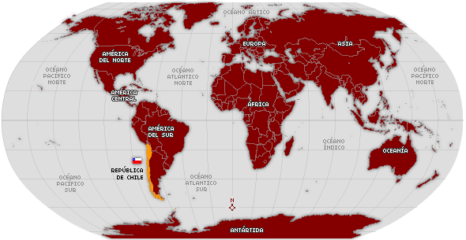
CHILE

Slide 3
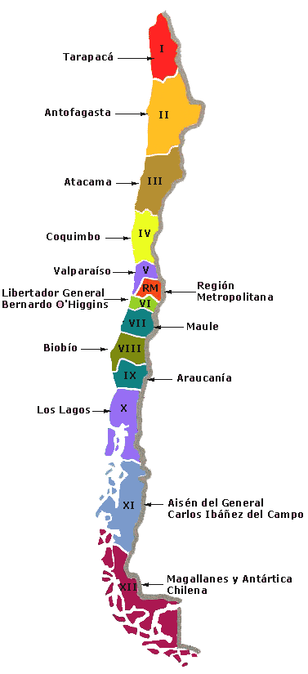
CHILE
CHILE

Slide 4
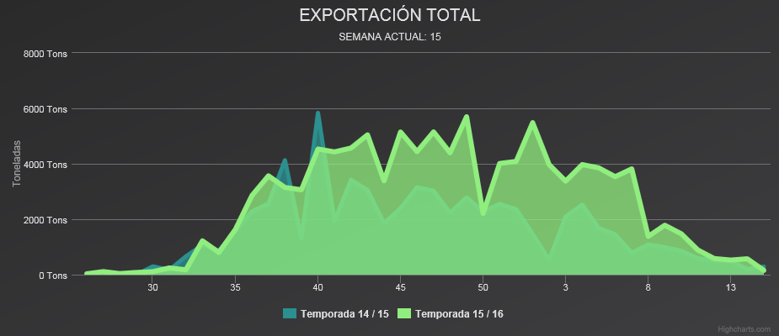
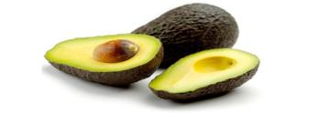
COMITÉ DE PALTAS HASS
Cumulative total by week 15
14 / 15: 67,407 Tons
15 / 16: 109,601 Tons
COMITÉ DE PALTAS HASS

Slide 5
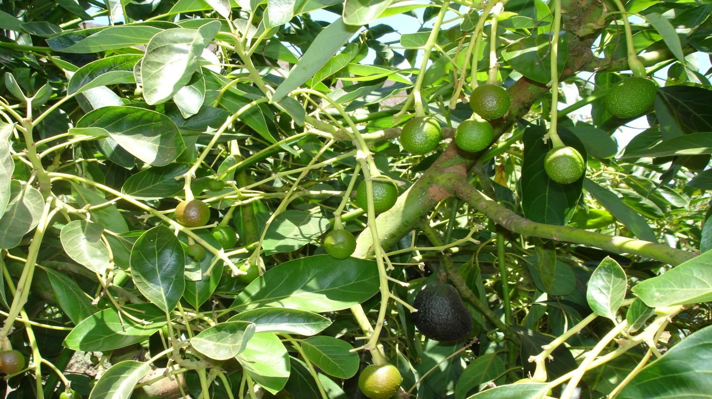

Slide 6
 | 2015 / 2016 Cumulative total to date |  | 2014 / 2015 Total |  | Variation
Market | Volume (Tons) | % | Volume (Tons) | % | 2015 / 2016 V/S 2014 / 2015
USA | 10,860 | 9.80% | 12,224 | 18.30% | -11.20%
Europa | 78,116 | 70.80% | 42,960 | 64.30% | 81.80%
Argentina | 11,459 | 10.40% | 9,513 | 14.20% | 20.50%
Total | 110,325 | 91.00% | 66,788 | 96.90% | 65.20%
COMITÉ DE PALTAS HASS

Slide 7
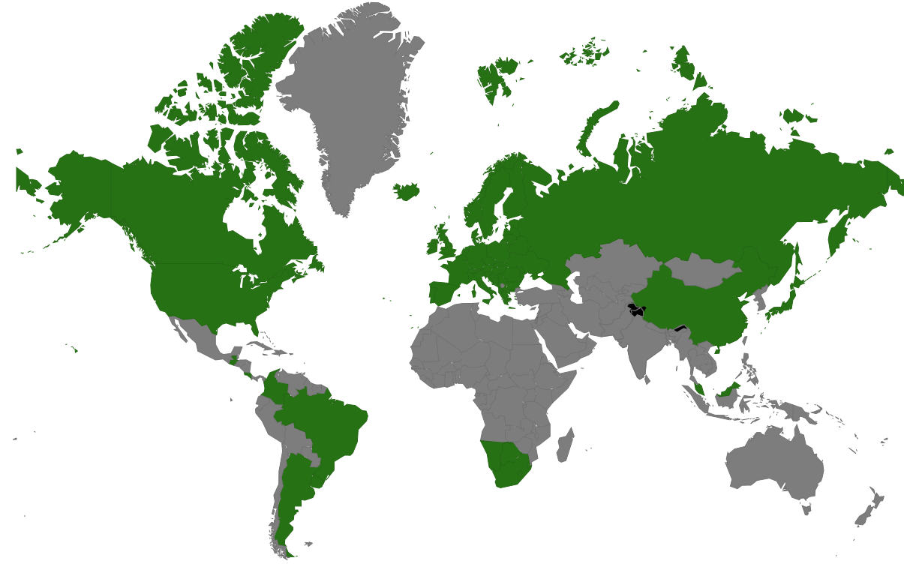
Possible export destinations for avocado
COMITÉ DE PALTAS HASS

Slide 8
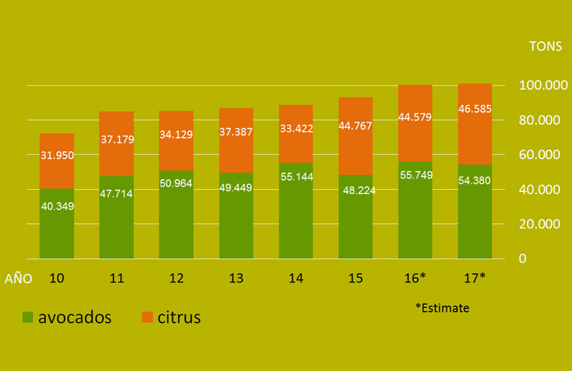

Slide 9
PROPAL S.A. Export Company
Founded by growers in 1976

Slide 13
Avocado Production in Chile
Up to the year 2007, there were about 38,000 hectares in Chile.
Today it is estimated that there are only about 22,000 hectares.
National production is about 170,000 tons.
The national market absorbs about 30% of the fruit produced in Chile.

Slide 14
Current Problems in Avocado production
Increasing costs (labor, electricity, fertilizers,& etc.)
Orchards planted on hillsides, resulting in increased maintenance difficulties in pruning and harvest
Low currency exchange rates (three years ago it was at 480 Chilean pesos per US dollar), at present it has reached about 680.

Slide 15
Current Problems in Avocado production
Aging orchards with low yields per hectare (national average is about 7.5 tons/ha).
Orchards damaged by the extensive drought in Chile (for about 7 years).
Overcrowded canopies due to lack of pruning, and to bad decisions by growers to hold fruit on the tree until late in the season, without any pruning.
Very late harvesting due to growers hoping for higher caliber fruit with better returns.

Slide 16
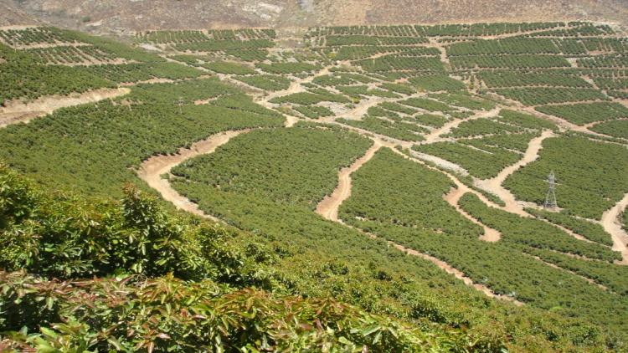
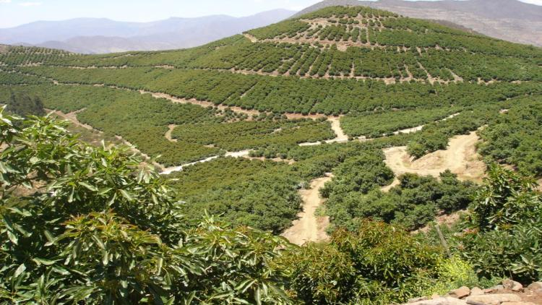
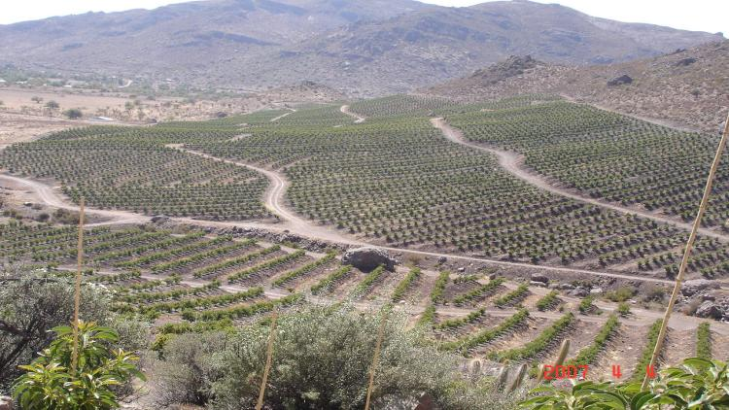

Slide 17
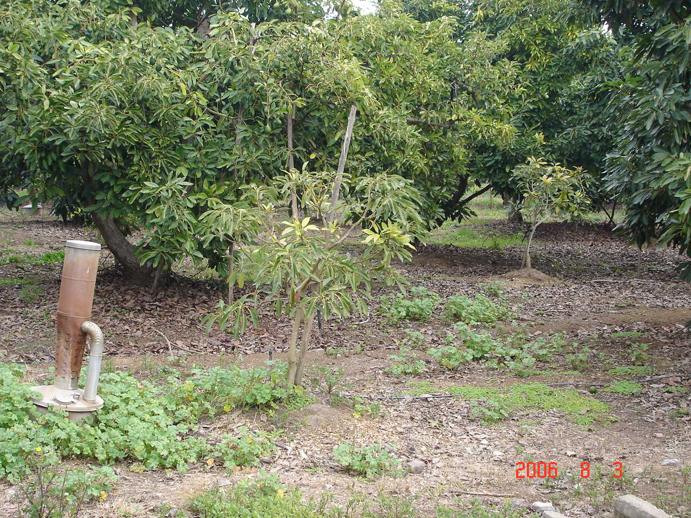

Slide 18
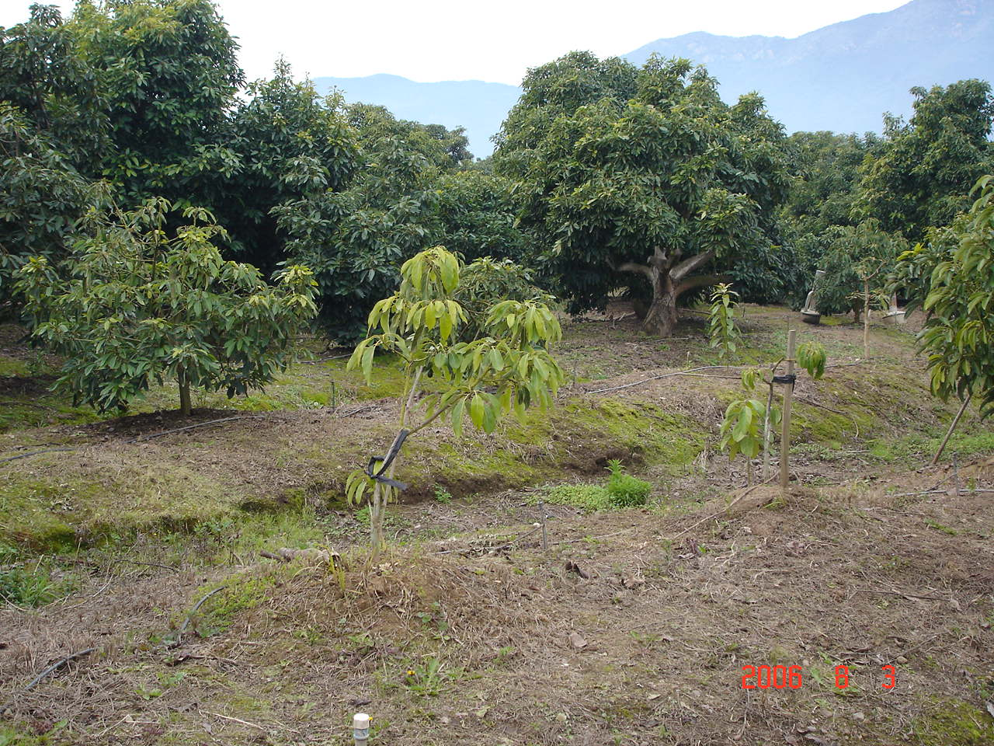

Slide 19
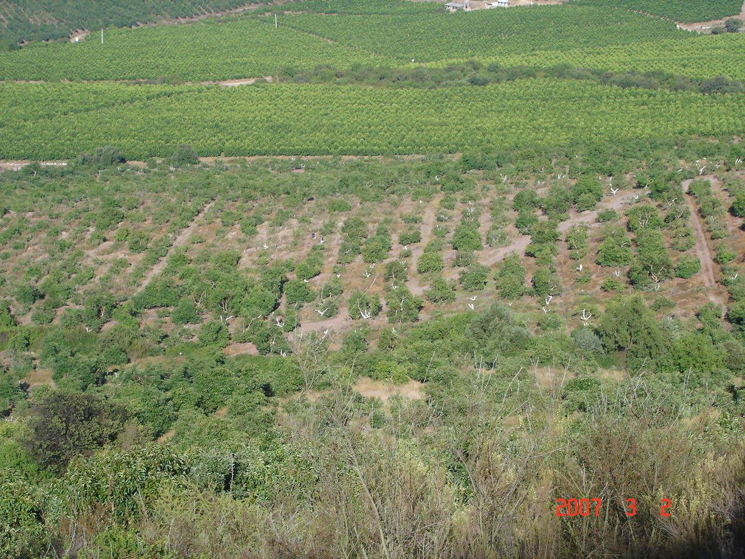

Slide 20
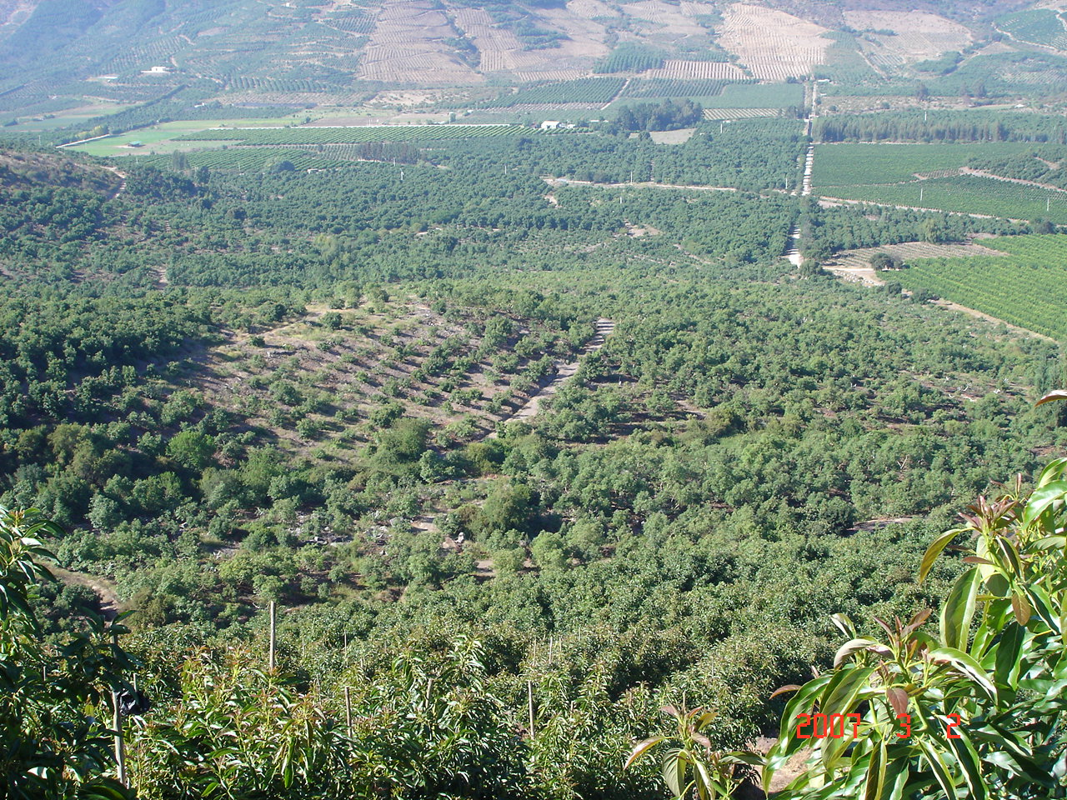

Slide 21
Economic exercise:
If the cost of production per hectare is $8,000 dollars, and a typical return is about $1 per kilo, then a minimum of 8,000 kilos per hectare must be produced just to cover costs.
It costs about $45,000 to buy land and plant the orchard. If we require a minimum return on business investments of 10-15 %, we must earn at least $4,500 to $6,750 per hectare in profit.
This means that we must produce at least 12.5 to 14.7 tons per hectare in order to have a profitable business.

Slide 22
Dollars |  | Margin
Total Investment per hectare | $45,000 | 15% | 6,750
Cost per hectare |  |  | 8,000
Total |  |  | 14,750
Return | $1 per kilo
Total Kilos per hectare |  |  | 14,750

Slide 23
Solutions
Improve sales and returns per hectare.
How?
Finding lucrative new markets (Europe, China).
Marketing (is one of the most important factors but most difficult to predict for growers).
Improve orchard yields.
How?
The first analysis should review which sectors of the orchard have lower yields per hectare over a period of time (ex: the last 5 years ).

Slide 24
How can we improve yields in avocado orchards?

Slide 25
1.- Replanting using more resistant clonal rootstocks.
2.- Severe pruning. Lowering the canopy.
3.- Pruning aggressively on one half (as in pruning on every other lane).
4.- Injecting with potassium phosphonate (phosphite).
5.- Controlling irrigation and fertilization.

Slide 26
PART II

Slide 27
Felipe Brunet Münnich
Agronomist, Avocado and Citrus advisor
Director of the Technical Departament, Propal.

Slide 28
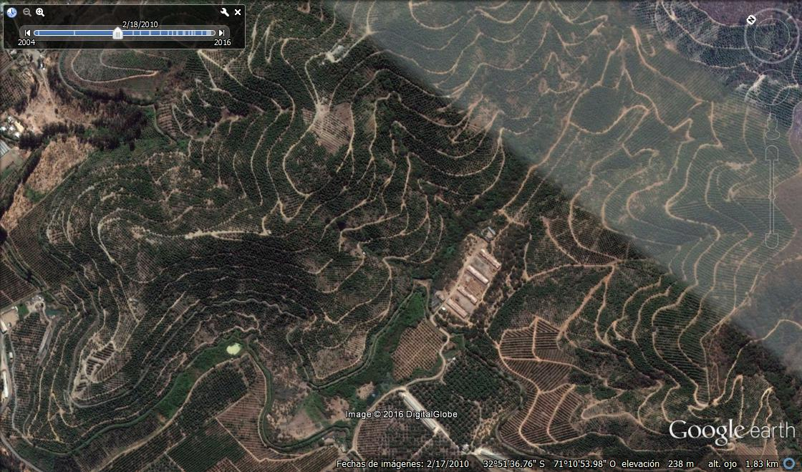
1.- Replanting

Slide 29
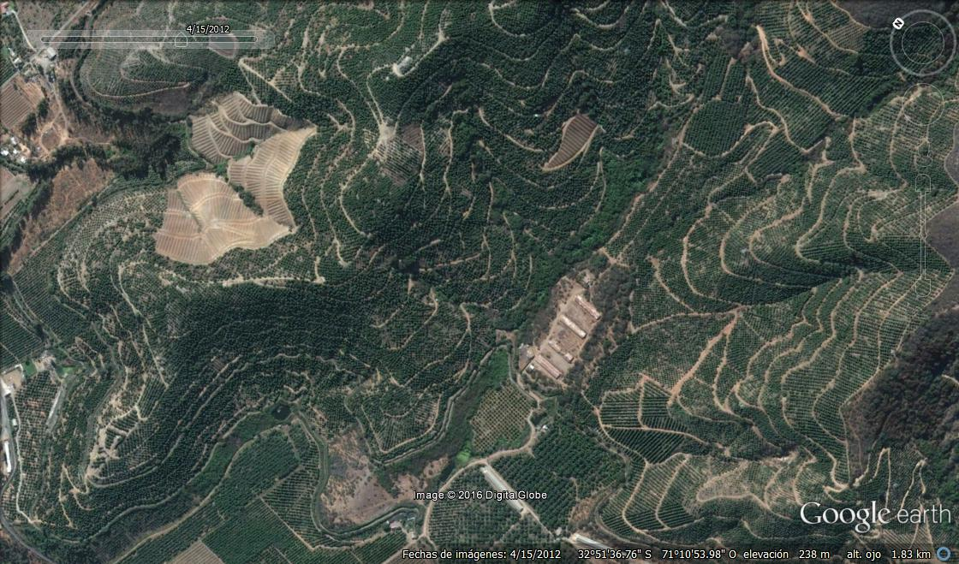

Slide 30
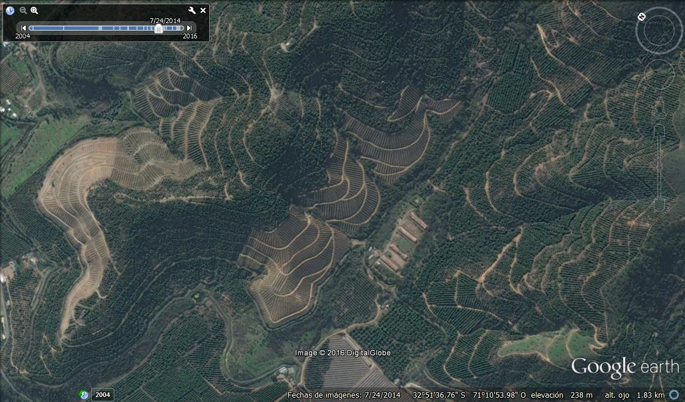
 | Huerto 3 6x3
 | Duke 7 ton/ha | D-9 kilos/ha | Toro Canyon Kilos/ha | Dusa Kilos/ha
2014 | 2,751 | 4,976 | 3,284 | 3,307
2015 | 15,111 | 18,363 | 19,567 | 22,366
Second harvest
Huerto 3 6x3
Duke 7 ton/ha | D-9 ton/ha | Toro Canon ton/ha | Dusa ton/ha
2.751 | 4.976 | 3.284 | 3.307
15.111 | 18.363 | 19.567 | 22.366

Slide 31
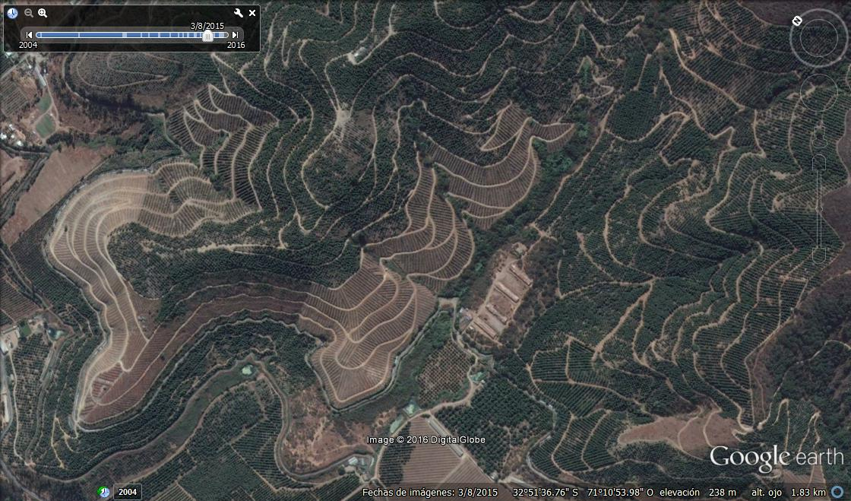

Slide 32
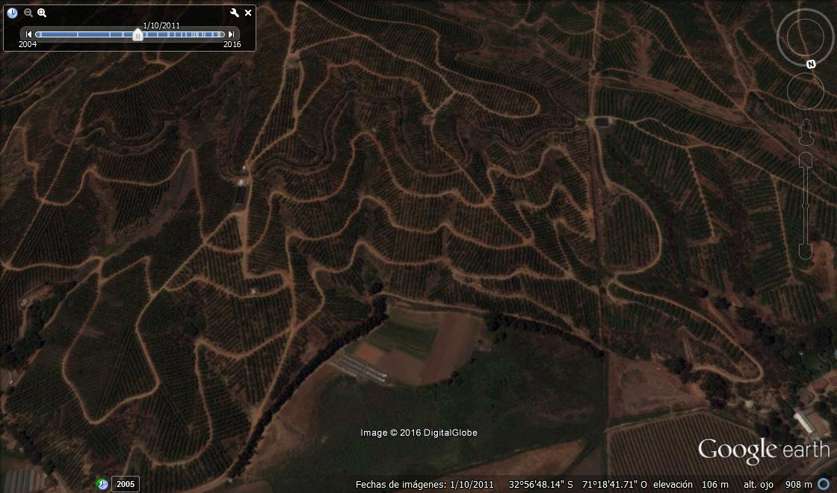

Slide 33
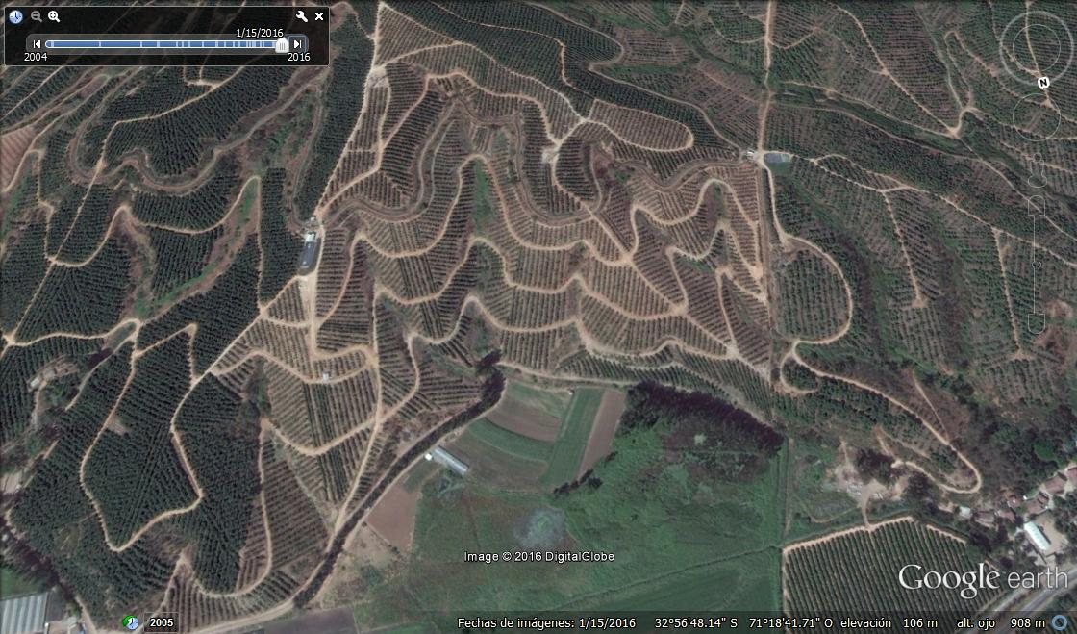
 | Huerto 1 6x3
 | Duke 7 ton/ha | Dusa ton/ha | Toro Canyon ton/ha
2014 | 4.500 | 4.000 | 7.600
2015 | 10.961 | 16.091 | 11.478
2016 | 18.000 | 18.000 | 18.000
 | Huerto 1 6x3
 | Duke 7 ton/ha | Dusa ton/ha | Toro Canon ton/ha
2014 | 4.500 | 4.000 | 7.600
2015 | 10.961 | 16.091 | 11.478
2016 | 18.000 | 18.000 | 18.000

Slide 34
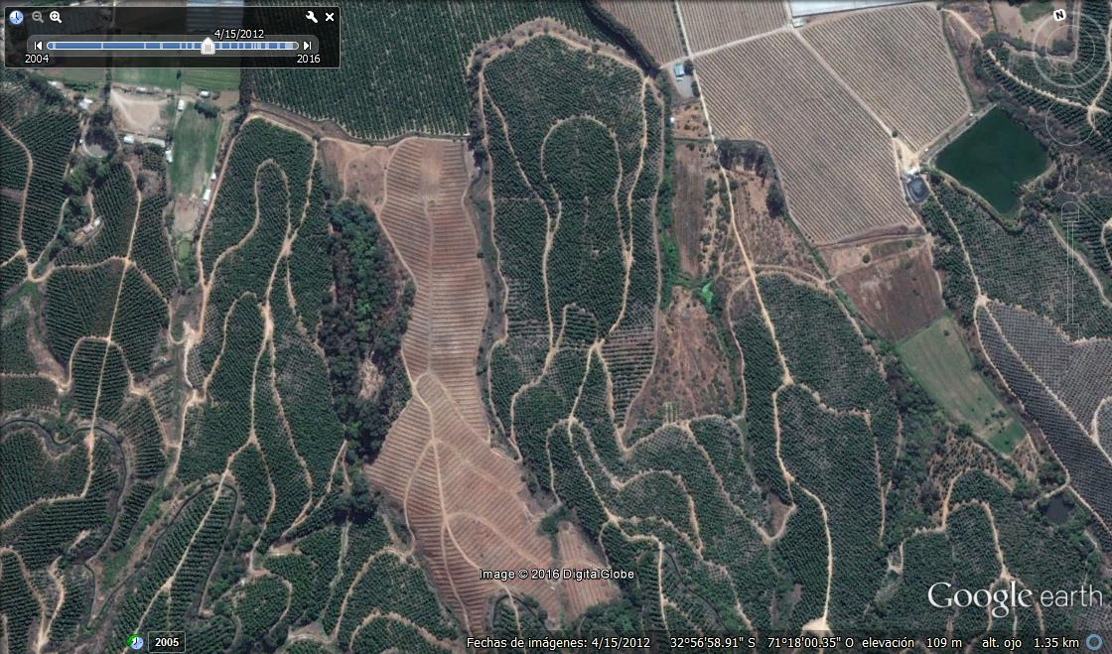
Spring 2011, the old, unproductive trees were pulled out and raised beds were rebuilt

Slide 35
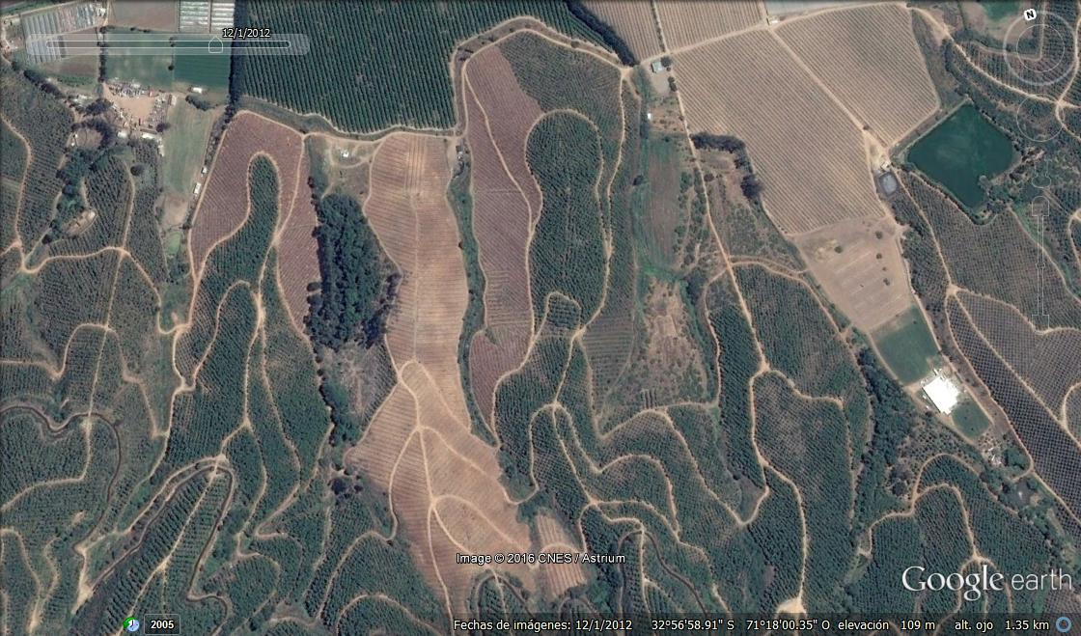
October 2012 (summer), two sectors of lower-producing, unhealthy trees, were severely pruned

Slide 36
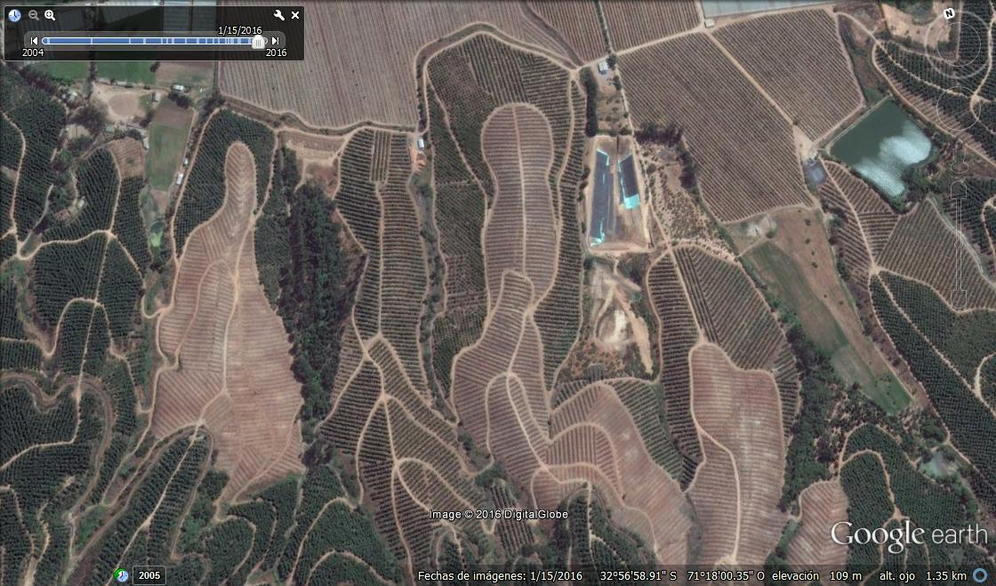
Severe pruning
2.012 | Pruning
2.013 | -
2.014 | 19.833
2.015 | 13.000
2.016 | 13.450
Huerto 2 6x3
 | Duke 7 ton/ha
2014 | 8.122
2015 | 22.988
2016 | 17.000

Slide 37
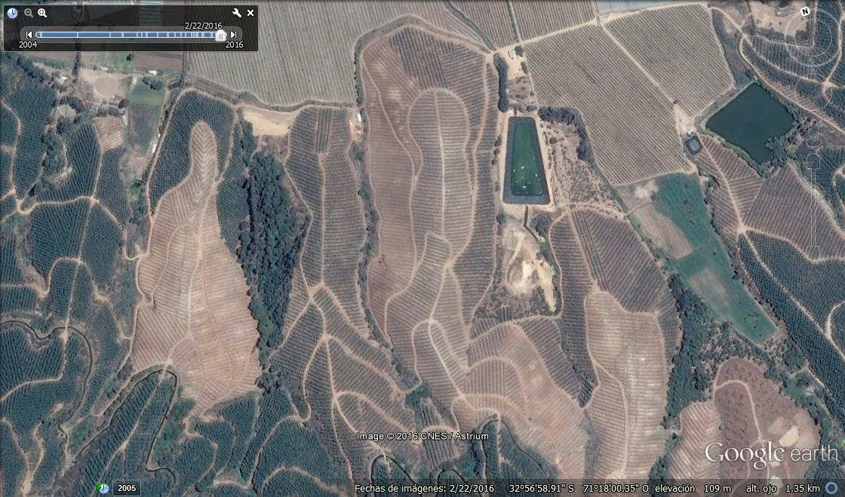
2016, replanting with clonal rootstocks.

Slide 38
Differences in the first three harvests between two seedling rootstocks and Dusa clonal rootstock.
 |  |  | KG/HA
LOCATION | PLANTING YEAR | VARIETY | 2013 | 2014 | 2015
Vivero 1 | 2010 | Mexicola/Hass | 15.040 | 17.600 | 22.169
Vivero 2 | 2010 | Dusa/Hass | 17.135 | 25.275 | 32.623
Vivero 3 | 2010 | Zutano/Hass | 14.021 | 18.260 | 25.543
Projection of yields per hectare, as actual production zones were smaller, with 200 trees each.

Slide 39
Replanting
Once the decision to replant has been made, appropriate rootstocks must be selected.
In the past we used Mexicola, Nabal, Zutano and Reed seedling rootstocks, with fairly typical results for replanting in avocado orchard soils.
Today the best choices are clonally propagated rootstocks. The alternatives available in Chile are:
Duke 7, Dusa, Borchard, Toro Canyon.

Slide 40
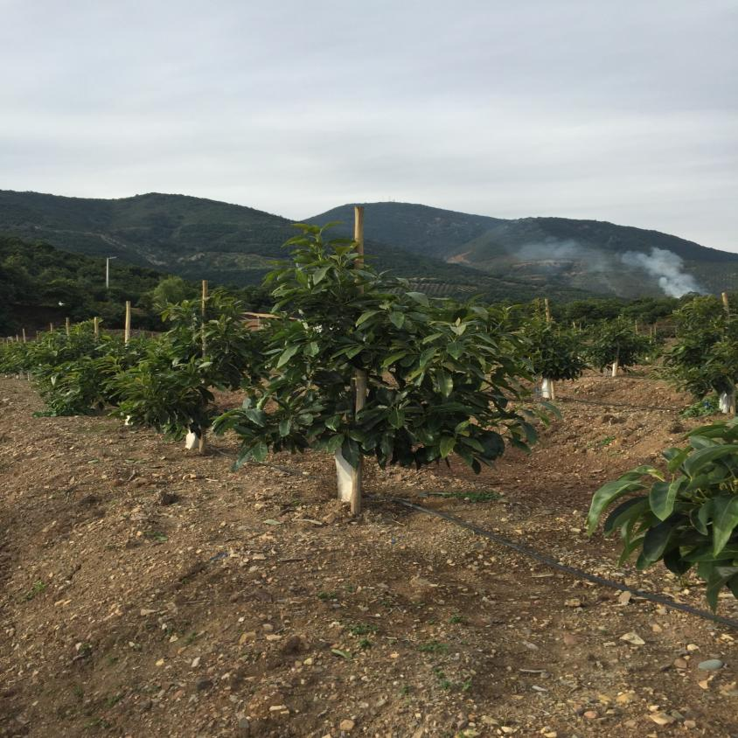

Slide 41
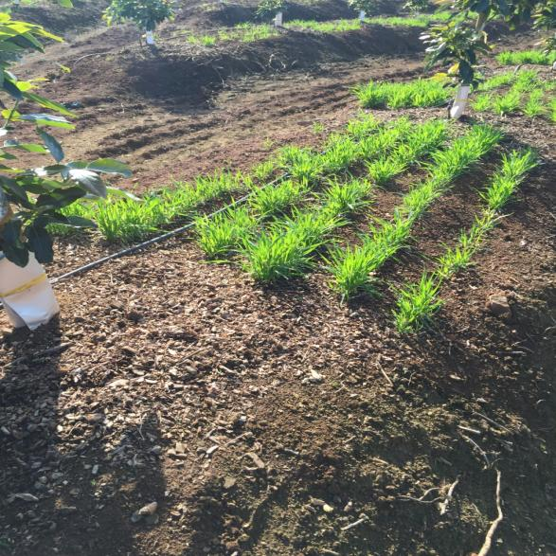
Growing barley between trees is being evaluated as a form of adding mulch and organic matter to orchard soils.

Slide 44
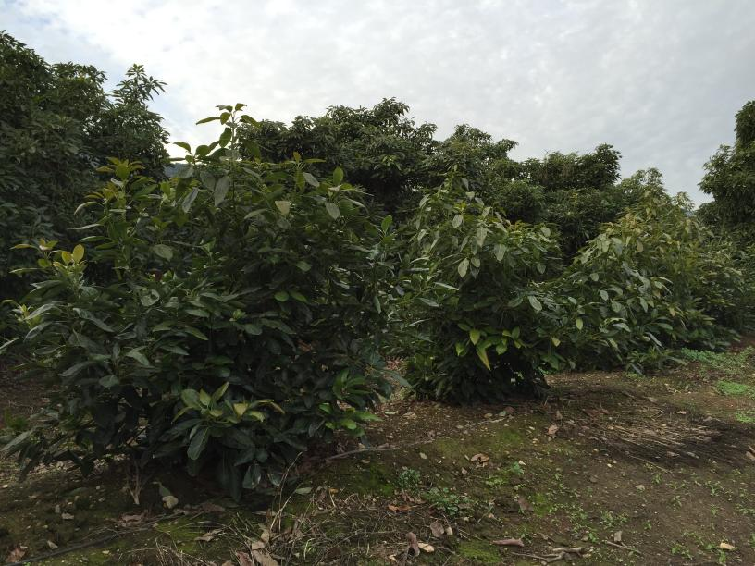

Slide 45
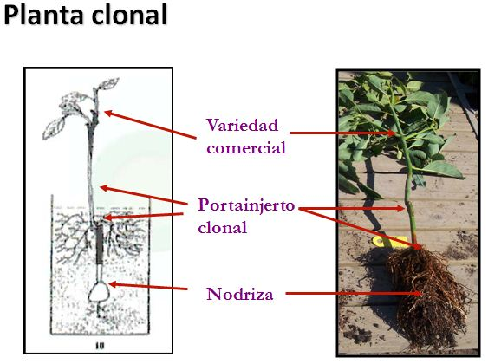
Mónica Castro y Claudia Fassio, Proyecto FONDEF. Pontificia Universidad Católica de Valpara, publicacion www.redagrícola.com

Slide 46
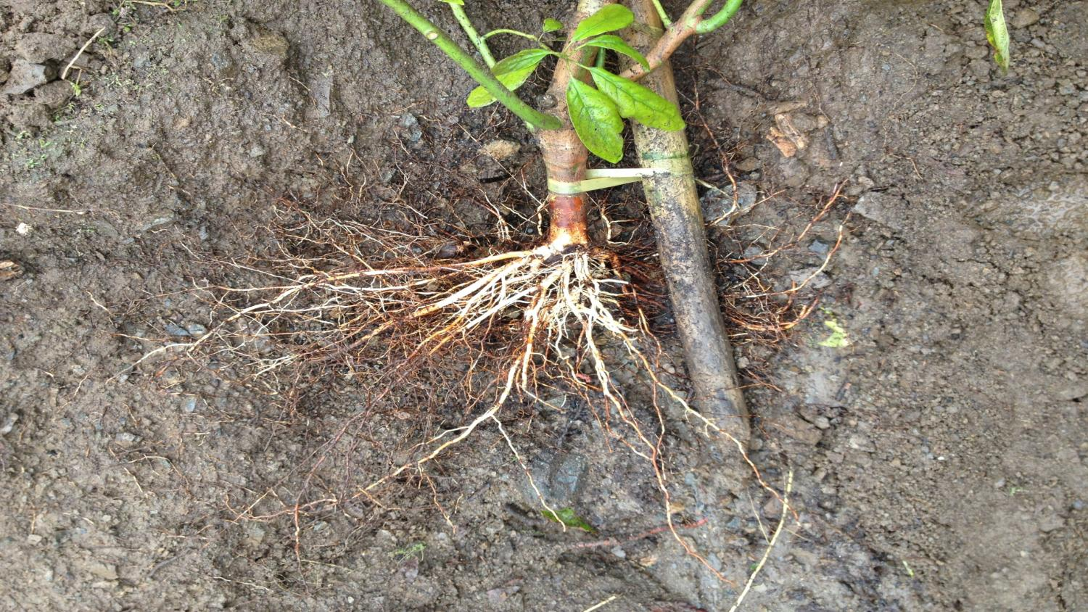

Slide 47
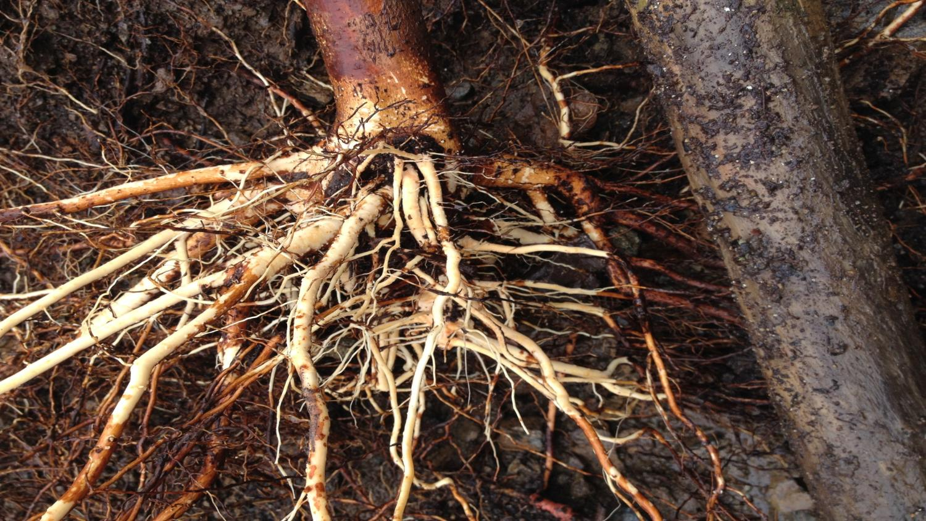

Slide 48
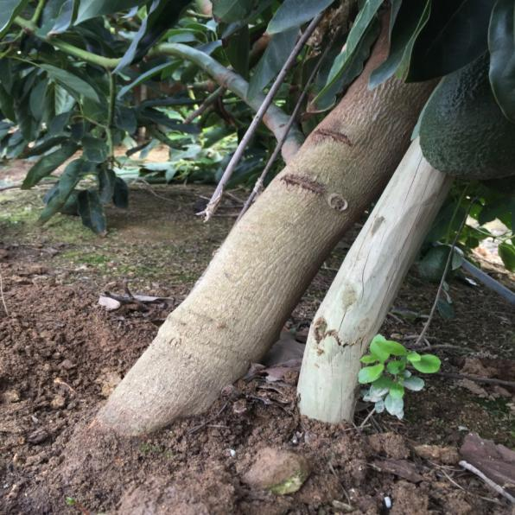
Some problems that we have in the field.

Slide 49
Depth of 1 m

Slide 50
Principal advantages and results
Less crowded planting densities, 6 X 3m or 6 x 4m, which permits harvesting over a longer period of time.
“More time and space for pruning”.
Increased uniformity of replanted trees. The new trees require practically all the same management, simplifying the labor.
Increased vigor for producing new branches and avoiding alternate bearing. This allows the potential for a greater number of girdling cuts to maintain higher and more constant yields.
Abundant first harvests (first 3) with notably higher yields achieved than in the trees with severe canopy pruning .

Slide 51
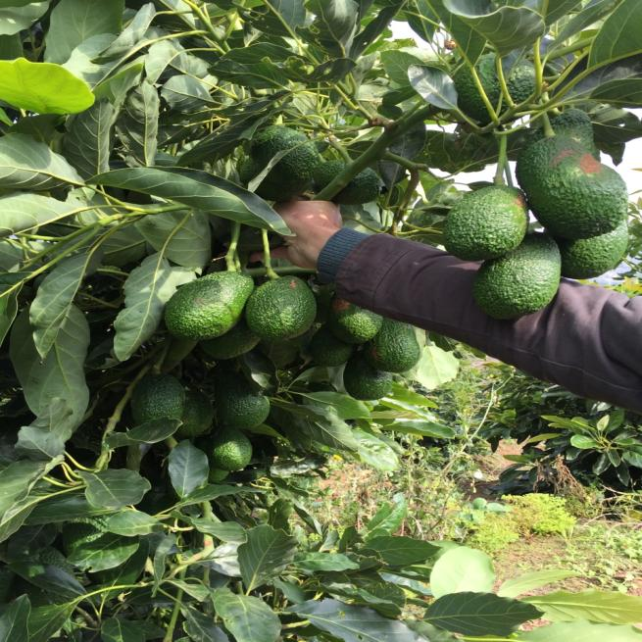
Really good fruit caliber

Slide 52
Considerations
Girdling is required at a young age, on more than 70% of the canopy.
PGR application is required for the first flowering to reduce vigor.
Later harvesting is also recommended to keep the trees less active.
Lower nitrogen fertilization is used because the root system is more aggressive and efficient.

Slide 53
2- Canopy reduction
It is recommended in cases of healthy but overcrowded orchards.
Vigor must be controlled with branch thinning, tip pruning, and girdling.
During the first flowering (with no older fruit present) applying PGRs helps control vigor and improve fruit set.

Slide 55
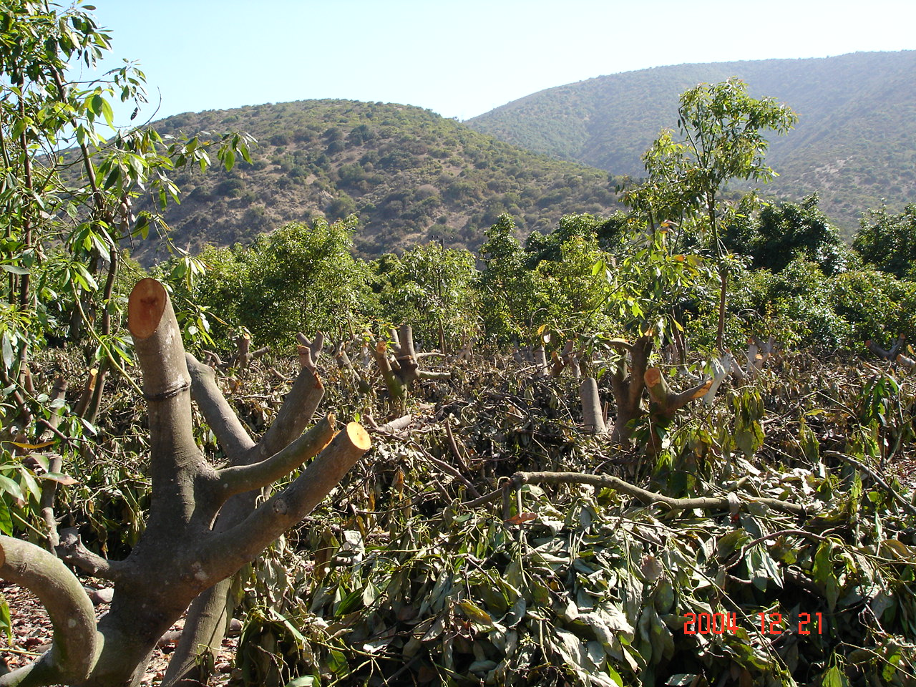
Rebajes
Rebaje
2.011 | Rebaje
2.012 | -
2.013 | 19.833
2.014 | 13.000
2.015 | 13.450

Slide 56
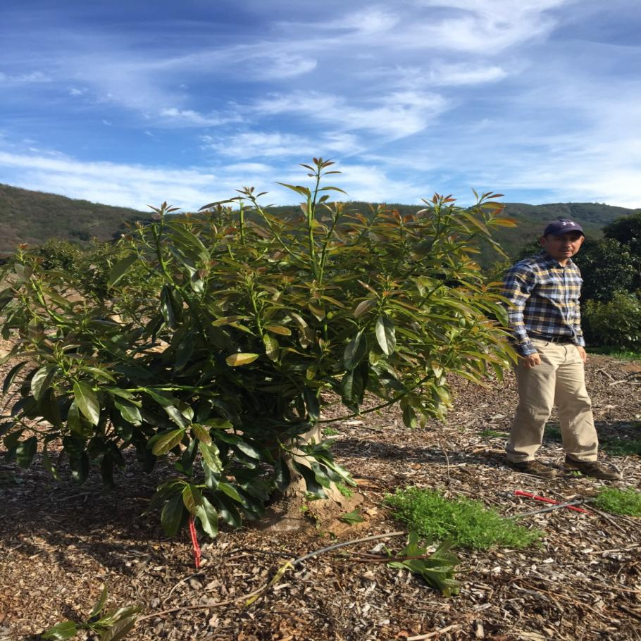

Slide 57
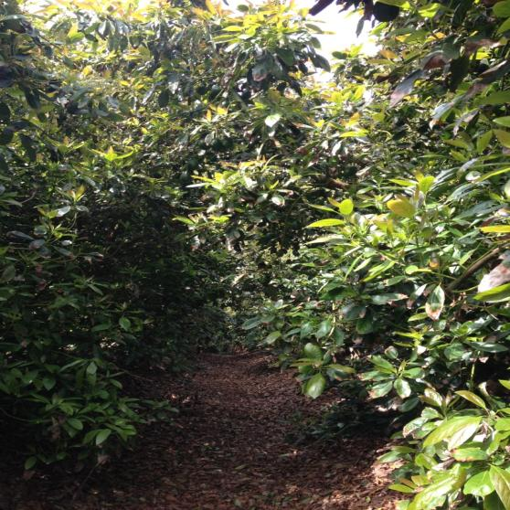
Pruning lanes

Slide 58
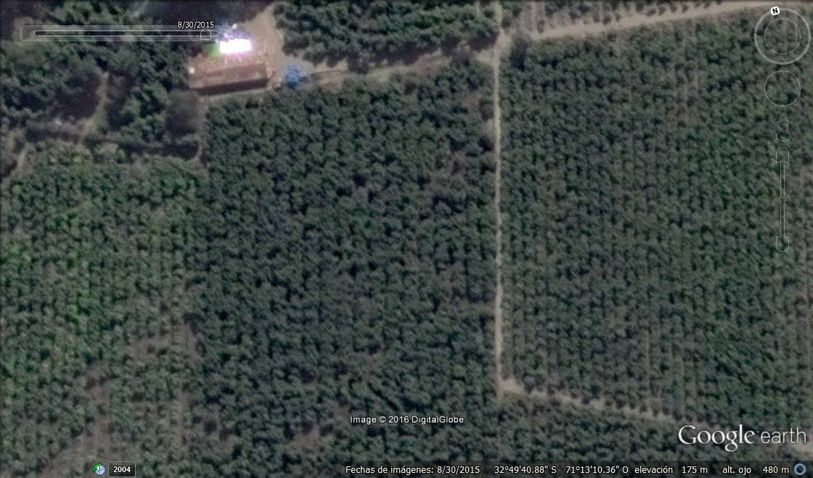

Slide 59
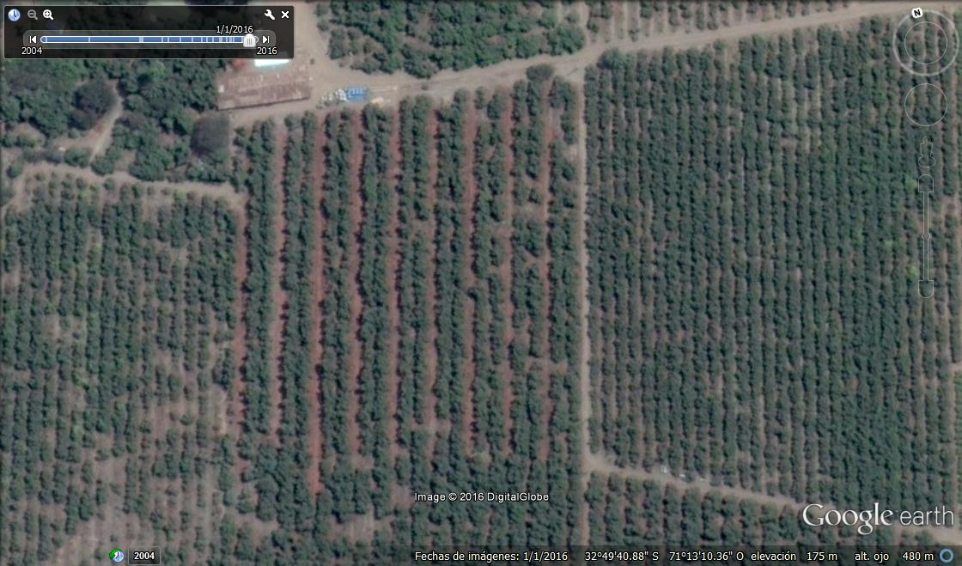

Slide 60
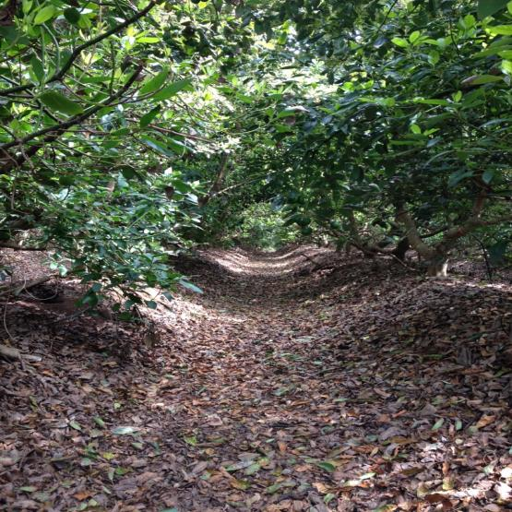

Slide 61
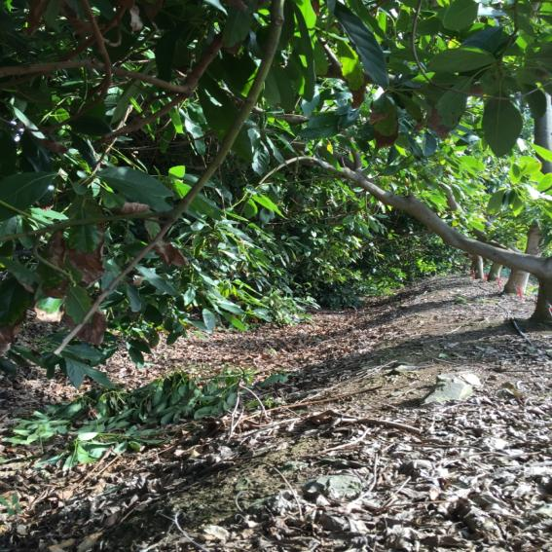
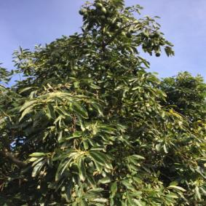

Slide 62
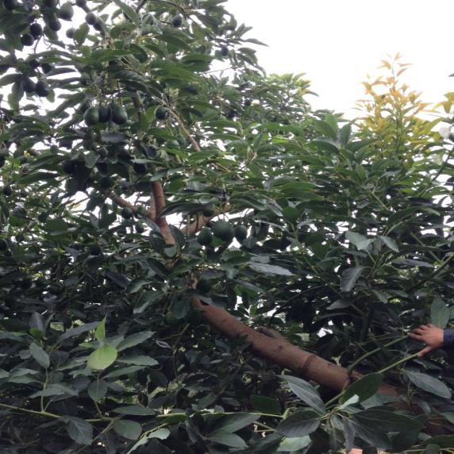
Girdling cut

Slide 63
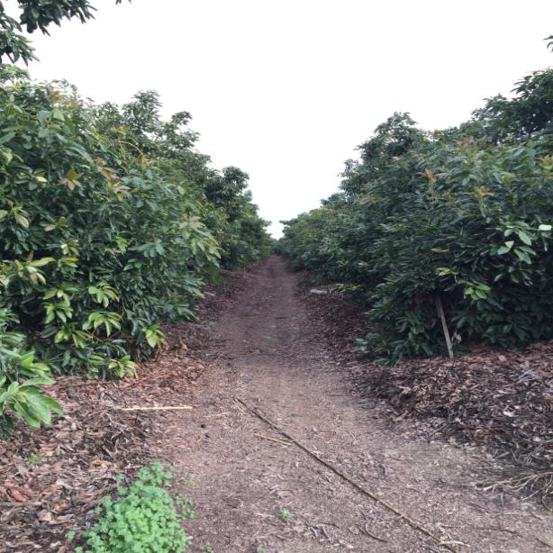

Slide 64
Injection of potassium phosphonate
Considerations
Maximum Residue Limit (MRL). Some European clients demand 1/3 of the standard European level, of 50 ppm, for avocado.
Do not inject branches with older fruit present.
Inject branches which will be girdled.
Inject during the autumn months at a concentration of 10% of acid equivalent.

Slide 66
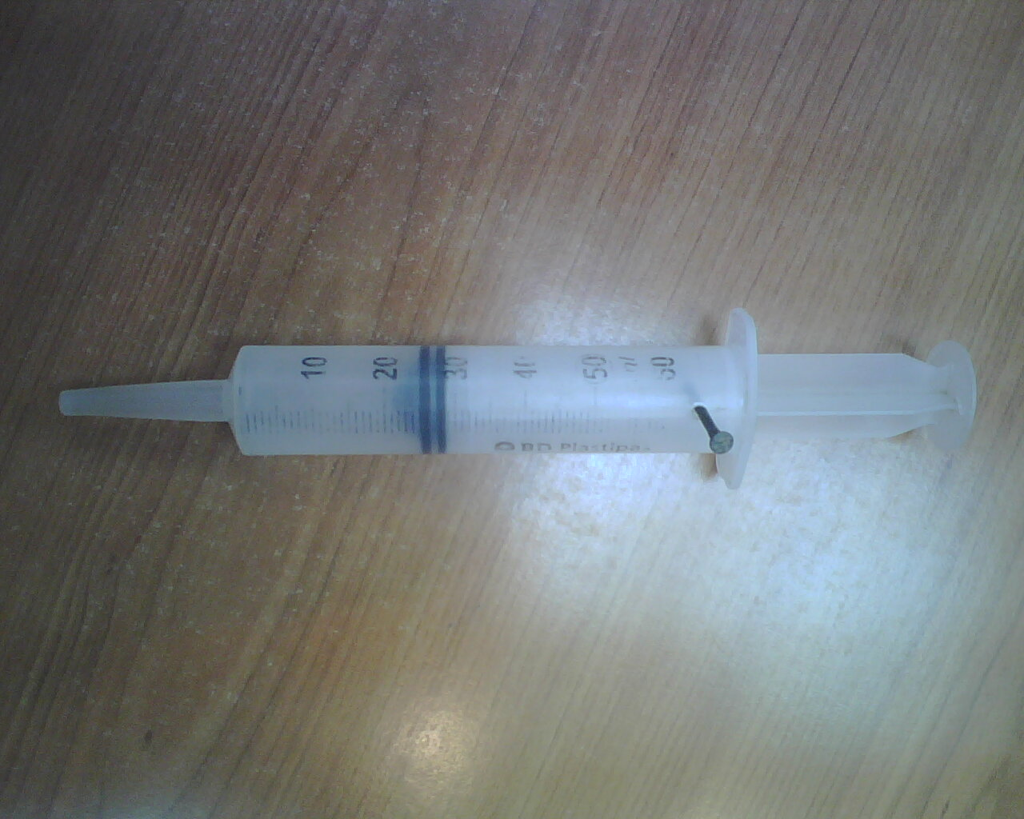

Slide 67
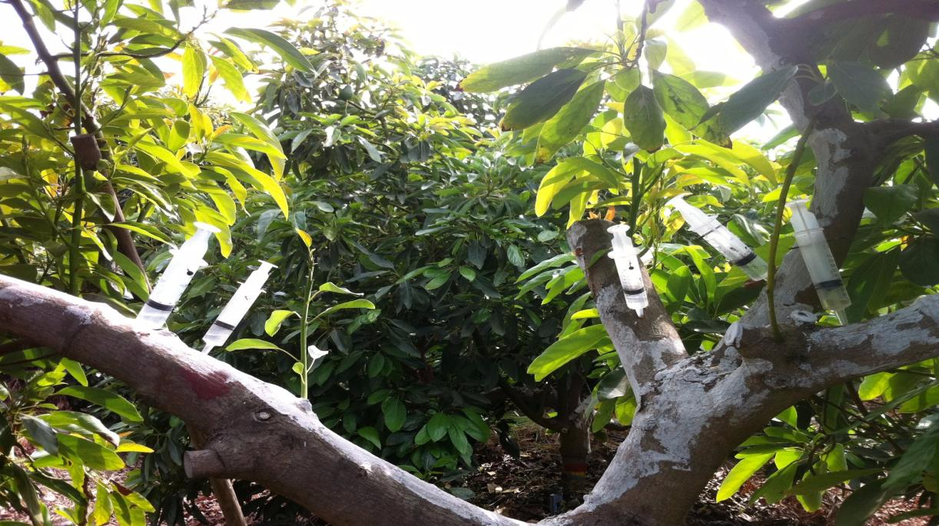

Slide 68
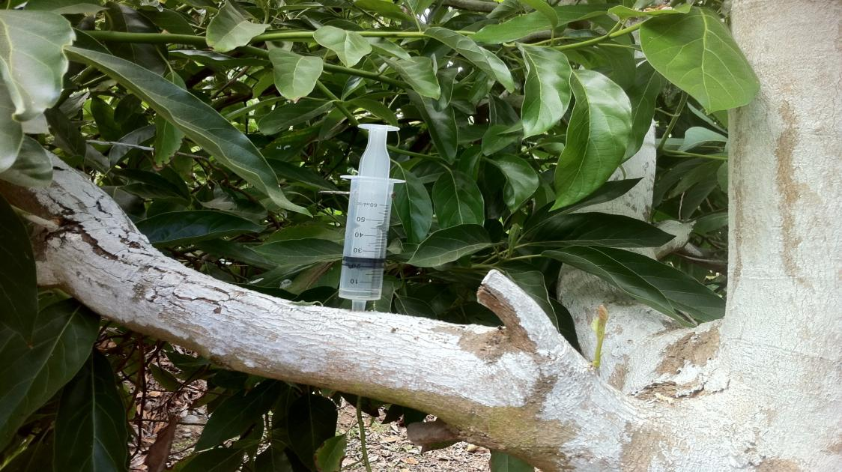

Slide 69
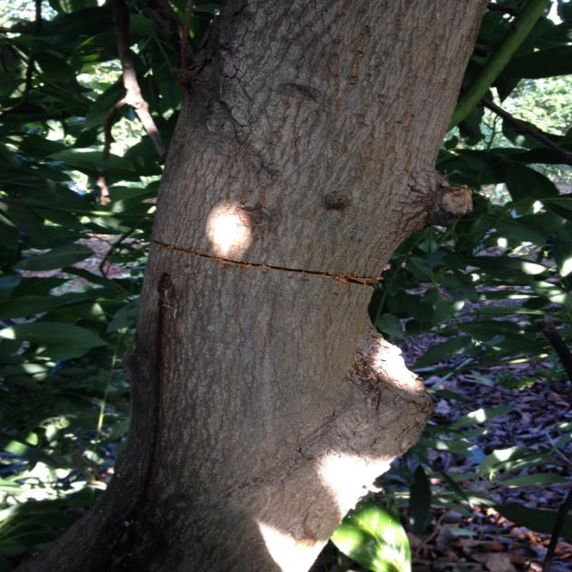
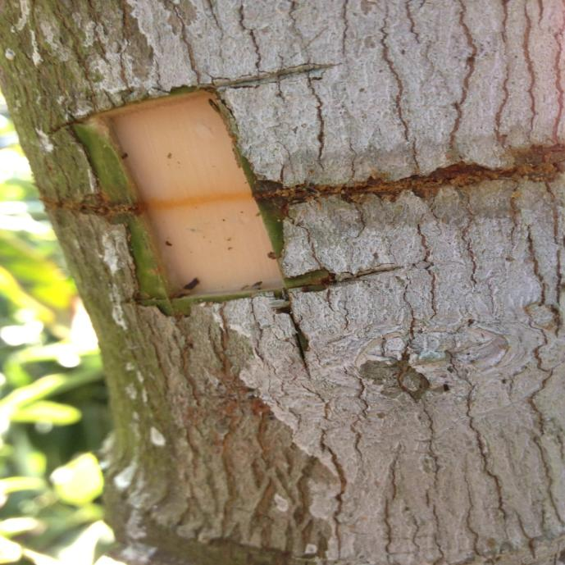
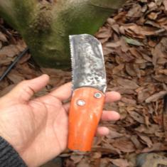
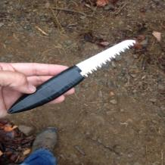
Regulation of girdling

Slide 70
Girdling
Management techniques like girdling reduce the transport of carbohydrates to the roots, weakening the tree.
Promoting increased flowering is a situation that should be avoided with weak trees.
Appropriate techniques need to be selected

Slide 72
Fruit thinning and earlier harvest.
One form of reinvigorating trees is to remove their fruit (hand-thinning, pruning).
Earlier harvesting of the fruit.

Slide 73
Irrigation and Fertilization
Some researchers (Whiley) suggest that high levels of Calcium and Ammonium are sporulation suppressors in Phytophthora. Work with composted manures shows that they supply Ammonium and Calcium Sulfate with high levels of Calcium.
Regular irrigation over longer periods can be done to take advantage of the increased soil depth of the raised beds.

Slide 74
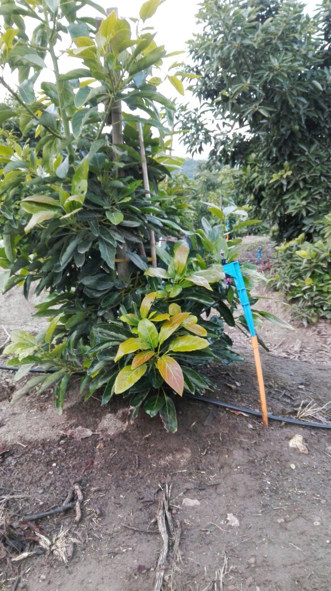

Slide 75
Thank you very much for your attention
Felipe Brunet Münnich
+5693591036
fbrunet@propal.cl

